Slide 1


Managing your medications
with help from your pharmacist
Dan Martinusen BSc(Pharm), ACPR, PharmD, FCSHP Provincial Director - Pharmacy – BC Renal

Slide 2
Disclaimer
All content in this presentation is for informational purposes only. It is not intended to be a substitute for professional medical advice and should not be relied on as health or personal advice.
Always seek the guidance of your doctor or other qualified health professional with any questions you may have regarding your health or a medical condition. Never disregard the advice of a medical professional, or delay in seeking it because of something you have seen or heard in this presentation.

Slide 3

Kidneys – the canaries in the coal mine
Kidneys are sensitive to:
  low oxygen
  low blood pressure
  high blood pressure
  dehydration
  obesity
  certain drugs
  high blood sugar
  reduced blood flow
  smoking
But the kidneys can compensate somewhat by…
Increasing oxygenation
Raising or lowering blood pressure
Regulating blood sugar
Increasing blood flow
Compensating for dehydration
But only to a point, then problems begin to occur…

Slide 4

What are the Causes/Risk Factors for Kidney Disease?
Diabetes
High Blood Pressure
Heart Disease
Smoking
Family History
Ethnic Origin
Age > 40 years

Slide 5
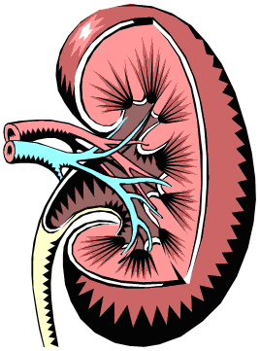
Managing
Your
Kidney
Health
Good blood pressure control
Good blood sugar control
Taking medications as prescribed
Maintaining a current medication list
Knowing what non-prescription medications are safe for you to take
Making healthy food choices
Smoking as little as possible or better yet not at all!
Getting some exercise
Following your blood work
Identifying what keeps your attitude positive

Slide 6
Topics covered
Can medications slow kidney decline?
What are some common medications used to help the kidneys?
How can I keep track of my medication?
Should I take my medications when I am sick?
Are there medications that can harm the kidneys (that I should avoid)?
What non-prescription meds are safe?

Slide 7
Medicines can slow the decline of kidney function, giving patients more time before dialysis
40
30
Kidney Function
Medicine
20
Placebo
8 years
10
Kidney failure requiring dialysis


0
0
5
10
15
20
Years
Age 62 with 40% kidney function, dialysis starts at age 71 or 79
Adapted from Heerspink, et al. "Dapagliflozin in patients with chronic kidney disease". The New England Journal of Medicine. 2020. 383(13):1436-1446

Slide 8
Ways To Control Your blood pressure
Self Management Strategy # 1
Take your BP medications as prescribed
Talk to a dietitian about limiting salt intake
Get your body moving - 30 minutes of exercise (most days) can reduce your SBP 5-10 points
Lose weight - taking off as little as 10 lbs can help reduce your SBP by 5-10 points
Learn how to manage your stress!

Slide 9
Why so many BP meds?
Each “class” of meds works in a different way
Using several classes at lower doses is better
β-Blockers (atenolol, metoprolol), Ca++ channel blockers (amlodipine), ACEI (ramipril, lisinopril),
ARB (candesartan, losartan), diuretics (furosemide, hydrochorothiazide), clonidine, methyldopa etc.
Most people require 2+ BP meds to control BP
ACEI, ARB, SGLT2i: early “eGFR dip” is ok but monitored by you doctor.

Slide 10
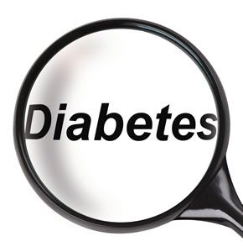
Blood Sugar Management
Self Management Strategy # 2
Controlling your blood sugar can:
help slow the damage being done to the filters of your kidney
prevent further damage to the blood vessels in your heart and the rest of your body

Slide 11
Know Your Blood Sugar Target
IDEAL RANGE
Fasting Glucose 4 – 7 mmol/L
2 hr after eating 5 – 10 mmol/L
A1c ideally less than 7%
Canadian Diabetes Guidelines (discuss your individual targets with your doctor)

Slide 12
Ways to Control Your Blood Sugars
Take your diabetes medications as directed.
Follow the diet recommendations.
Make an appointment with a dietitian or at a Diabetic Education Center for help and guidance.
Get your body moving to help burn the sugar.
Aim for a healthy waistline

Slide 13
Meds to Control Your Blood Sugars
Insulin (many types)
Many classes of oral medications
Metformin
SGLT2 inhibitors (canagliflozin, dapagliflozin, empagliflozin)
DPP4 inhibitors (linagliptin, saxagliptin, sitagliptin)
Sulfonylureas (glyburide, gliclazide)
Choice depends on the evidence of benefit and safety.

Slide 14
Controlling cholesterol
atorvastatin, lovastatin, rosuvastatin, simvastatin (“statins”)
Lower LDL (bad cholesterol)
Part of an overall heart and kidney disease prevention strategy
Not “instead of” diet modifications

Slide 15
Stop Smoking
Self Management Strategy #3
Smoking hurts your kidneys by:
Increasing your blood pressure
Damaging your blood vessels
Kidney and other cancers
Talk with your doctor /pharmacist

Slide 16
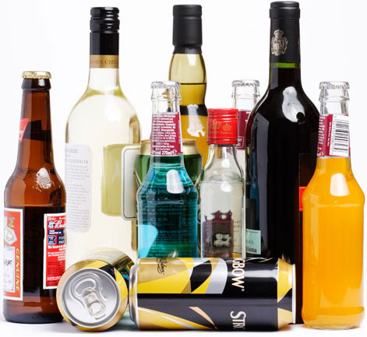
About Alcohol…
About Alcohol…
Did you know that alcohol will…
Increase your blood pressure?
Increase your blood sugars?
Impact the effectiveness of your medications?
Alcohol in moderation may be acceptable.
We encourage you to speak to your doctor about what is the right amount for you.

Slide 17
Understanding Your
Blood Work Results
Self Management Strategy #4
When you go to the lab, ask to receive an automatic copy of your results.
Learn about the tests your doctor is ordering and what they mean.
Prepare to talk about your results when you go to your medical appointments.

Slide 18
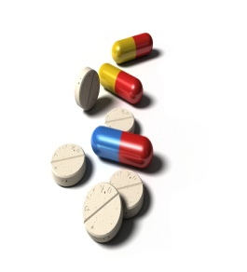
Maintain An Updated Medication Record
Self Management Strategy # 5
Keep a current list of all your medications (including non-prescription meds).
Take this list to all your health care appointments, including trips to the hospital.
Know the what, when, why and how of the medications you are taking.
Not sure if a medicine is kidney friendly? Ask the Pharmacist!

Slide 19
Medication Lists
For Your Own Safety
Keep an updated list of your medications with you at all times so that:
your doctors/dentist know what you are on
the hospital will know what you are taking
drug interactions/duplication are avoided
your medications are safe to take
Notes:
I can’t stress this point enough! Should you be unable to speak for yourself in an emergency room or if you are simply visiting a dentist, having an up to date medication list is essential and will save valuable time for you and your team to provide good care for you. Please, if you take only one thing away from this let this be it – carry a medication list with you!

Slide 20
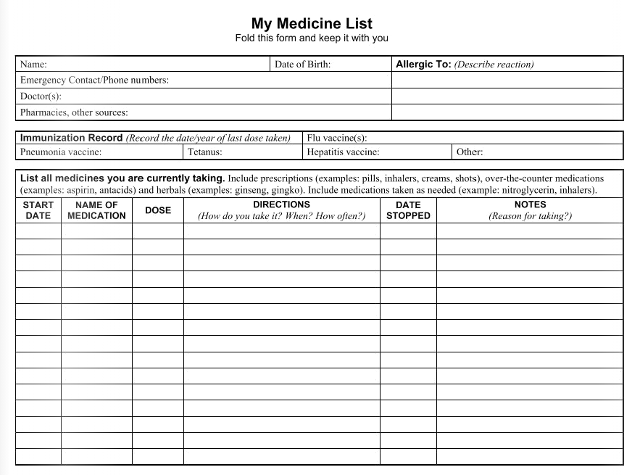
Notes:
Here is an example of a medication list which has been conveniently placed in your folders today. Please make copies of this and fill it in completely. Note there is a section “what is it for” – take the time to know this and write it in your own words. Ask your pharmacist if you are not sure.

Slide 21
Medication sick day rules
When you have more than minor vomiting, diarrhea, fever, sweats and / or shaking
Stop taking the medications below and restart when you are well (after 24-28 hours of eating and drinking normally)
If in doubt, contact your pharmacist, nurse or physician
ACE Inhibitors (ramipril, lisinopril, others ending in “pril”)
ARBs (losartan, candesartan, irbesartan others ending in “sartan”)
Diuretics (furosemide, hydrochlorothiazide, chlorthalidone)
Metformin for diabetes
NSAIDS (ibuprofen, diclofenac, naproxen, ketorolac, for example)
SGLT2i (canagliflozin, dapagliflozin, empagliflozin)
Sulonylureas for diabetes (gliclazide, glyburide, glimepiride)
www.bcrenal.ca/resource-gallery/Documents/Medication%20Changes%20When%20You%20Are%20Sick.pdf

Slide 22

About Your Pharmacist…
Your pharmacist is on your team to help you optimize your health
Ask questions…pharmacists are available without an appointment!
Pick up the telephone or drop by your local pharmacy
Notes:
It’s OK to ask. Pharmacists are quite happy to help you. If they don’t have the answer, they are quite good at looking it up or knowing who would know.

Slide 23
About Medication Changes
As your kidney function changes, so will your medication needs.
What you currently take now will not necessarily meet your needs over time.
Your healthcare providers will work with you to ensure you are getting:
what you need, when you need it, and
in the right dose.
Notes:
If your kidney function declines, your medication needs may go up or down. If your blood pressure goes up, you may need more medication yet if you are able to eat better, achieve a goal weight, exercise and stop smoking, for instance, your blood pressure may go down and medication may be reduced. The important point is that you are given the right medication in the right amount for you.
How many of you are on one blood pressure medication (raise your hand to indicate a show of hands), TWO? (Keep hand raised) Three? (raised hand) FOUR? (Raised hand). We often will use more than one medication to control blood pressure because they each work in different ways to reduce blood pressure and certain combinations will provide a better benefit that you might expect and may even be chosen to treat another condition you may have. There are many blood pressure medications out there so please, if you think you may have a side effect, talk to us about it!

Slide 24

Balancing All Your Medicines
Maximize the effect of the medicines you take to:
Ensure the best absorption for instance, with or without food
Ensure you experience the fewest side effects
Talk to your doctor or pharmacist about flexibility around dosing and timing. (e.g. pain, nausea)
Notes:
If a medicine is not quite working well for you, talk to us about it so we can make things better.
MARY POPPINS SLIDE – a spoonful of sugar helps the medicine go down, in the most delightful way!
Labels on the side of pill bottles – get older, type gets smaller

Slide 25
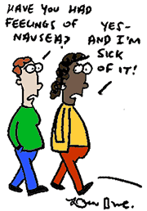
Reducing Side Effects
Medications have benefits but they can cause side effects. Our job is to minimize the side effects while maximizing the benefits
Talk about side effects when a new medicine is prescribed and make a plan to minimize the negative effects. Medications may be taken differently or even switched.
DON’T SUFFER IN SILENCE!
Notes:
The take home point here is “Don’t suffer in silence”

Slide 26
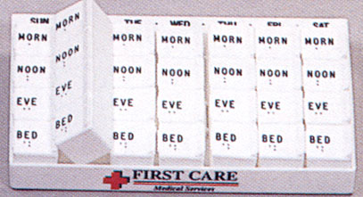
Organizing Your Medications
Medications lists
Relatives
Calendars
Tablet organizers
Blister packs
What works for you?
Notes:
I don’t know about you but I need some help to remember to take my medication. Fortunately there are a number of ways available and one may work for you. If you have a complicated schedule, a blister pack may be right and you can speak to your doctor about that. Usually these are a week’s medication packaged in a card so that each dose time has all the tablets for that time. Tablet organizers are another great way to help out but someone needs to set this up each week. Pictured here is a tablet organizer. Relatives are great but be cautioned – it seems that wives are better at reminding husbands than the other way around – you know what I mean! Medication calendars are also handy to help remind you that you have taken a dose or that one is due.

Slide 27

What to Avoid
Some Herbal preparations
- the unknown….
- not regulated by the HPB
- https://www.herbalckd.com/
Vitamin preparations
- avoid high doses of Vitamin A and C
Notes:
A note about herbal medications: Yes, many people take these and some have proven benefit but unfortunately none have been studied in paeople with kidney disease specifically. Some herbals are well known to cause or make kidney problems worse. If you are taking an herb and would like to discuss it, talk to me afterwards. Blood pressure, kidney function and blood sugars may be adversely affected by different herbals.
A short word on vitamins – once again – if you have a question about a particular one – talk to me afterwards. The fat soluble vitamins ADE&K tend to be in abundance in kidney disease and you likely don’t need supplementation. If you have been recommended to take Vitamin D given our climate or for your particular health concern, this should be fine at your stage of kidney disease. Avoid doses of vitamin C greater than 500 mg and you should not need nor take large doses of vitamin A.

Slide 28

Pain/anti-inflammatory medications
over the counter: aspirin – Tylenol is OK
over the counter: ibuprofen (Advil,Motrin)
prescription : NSAIDs (indocid, naproxen)
- Cox 2 inhibitors (Celebrex)
Cold and flu preparations
- containing decongestants
- containing aspirin type meds
Notes:
So we have encouraged you to exercise and we all know that can cause pain afterwards. Now I’m going to tell you to avoid aspirin, ibuprofen, Advil, Motrin and drugs like those. Not only can these cause you stomach problems such as ulceration, but your blood pressure and kidney health can be made worse. Prescription versions of these go by a variety of names so be sure to let your prescriber know you have a kidney problem. Now this is a balancing act if you have arthritis but our goal should still be to minimize your amounts of these in preference to more kidney friendly pain medications. A number of alternatives are out there so please ask! One such safe medication for pain is acetaminophen or Tylenol.
For cold preparations, how many of you take a tablet or capsule that promises to cure your sore throught, runny nose, itchy eyes, suppress your cough and stop your sneezing? These medications may contain aspirin or ASA as I mentioned may not be good for you. Additionally & unfortunately these medications can raise your blood pressure and your blood sugars as they often contain psuedoephedrine or similar that end in “phrine”. Rather that taking this by mouth and having the drug go everywhere in your body, why not just apply it to your nose in the form of a nasal spray so you congestion is reduced without raising your blood pressure? Otrivin or neosynephrine are two such examples. In your package is a guide to non-prescription medication that I encourage you to have handy should you need a remedy.

Slide 29
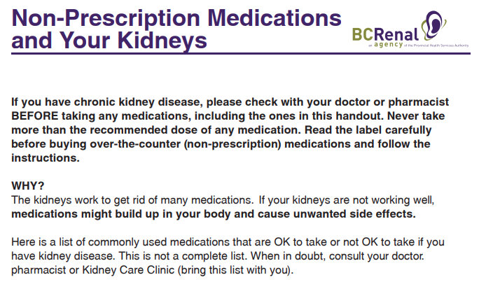
http://www.bcrenal.ca/health-info/managing-my-care/medication#Conditions--&--Treatment

Slide 30
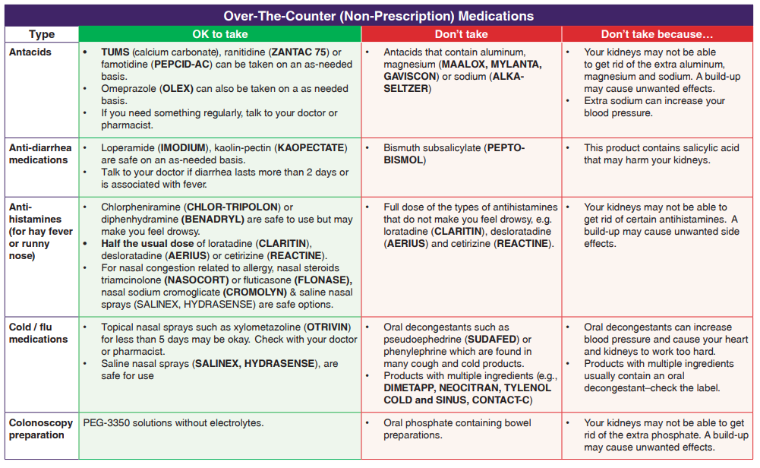

Slide 31
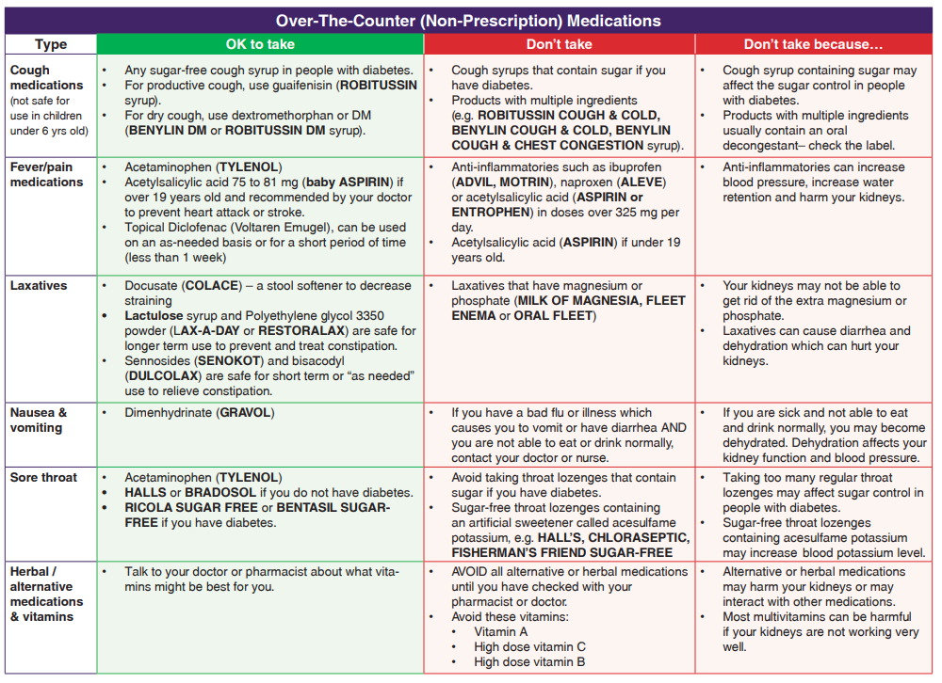

Slide 32
Useful resources
http://www.bcrenal.ca/resource-gallery/Documents/Non-Prescription%20Medications%20and%20Your%20Kidneys.pdf
www.bcrenal.ca/resource-gallery/Documents/Medication%20Changes%20When%20You%20Are%20Sick.pdf
http://www.bcrenal.ca/health-info/managing-my-care/medication#Conditions--&--Treatment

Slide 33

bcrenal.ca
@BCRenal

