Slide 1

Best Practices in the Assessment and Identification of Thrombotic Occlusion in Hemodialysis CVCs

Slide 2
Acknowledgements
This presentation was developed by a Scientific Development Committee which included:
Alana Campbell, RN , MN, CVAA(C)
Calgary Urban Zone Alberta Health Services, Calgary, AB
Gail Barbour , RN, CNeph(C)
London Health Sciences Centre, London, ON
Paula Mossop, RN, CNeph(C)
QEII Health Sciences Centre, Halifax, NS
This presentation was funded by Hoffmann-La Roche Limited
The BC Vascular Access Educators Group reviewed the content in this presentation and made minor modifications to align it with BC guidelines and practices.

Slide 3
Learning Objectives
UPON COMPLETION OF THIS PROGRAM THE PARTICIPANTS WILL BE ABLE TO:
Utilize best practices for the assessment of CVCs prior to, and during dialysis
Identify different thrombotic occlusions based on assessment skills
Understand the consequences of a dysfunctional CVC

Slide 4
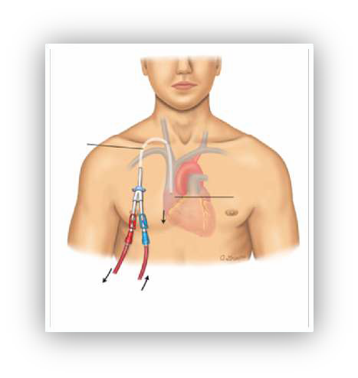
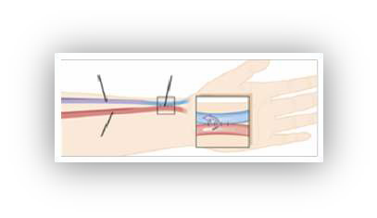
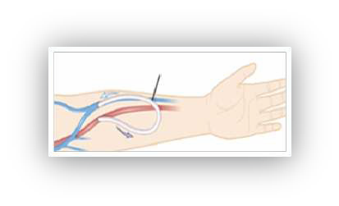
Factors Influencing Hemodialysis
Access ^{1,2}
Types of Long Term Access:
Factors that influence access include: Life expectancy, time to dialysis, referral timelines, suitability of vessels, risk of complications, patient choice
AV Fistula (AVF) (* First choice when possible)
AV Graft (AVG)
Central Venous Catheter (CVC)
Catheter
Vein
Fistula
Right atrium of heart
Artery
Graft
Blood to dialysis machine
Blood from dialysis machine
KDOQI 2006 Clinical Practice Guidelines and Clinical Practice Recommendations, Vascular Access, 2006.
Graham, J et al. Nephrol. Dial. Transplant 2008 Nov;23(11):3585-91.

Slide 5
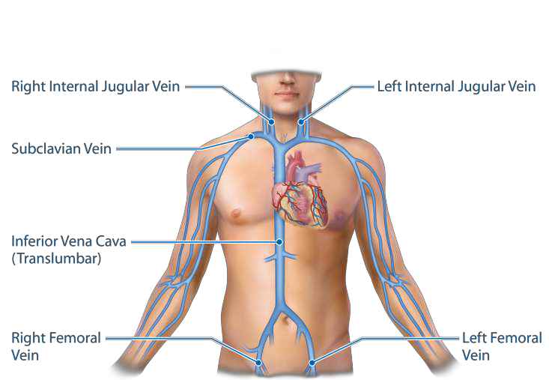
Access Sites Used for CVCs
Right External Jugular Vein
Left External Jugular Vein
Adapted from Shier D. Hole's human anatomy & physiology. Dubuque, IA: W.C. Brown Publishers; 1996.

Slide 6
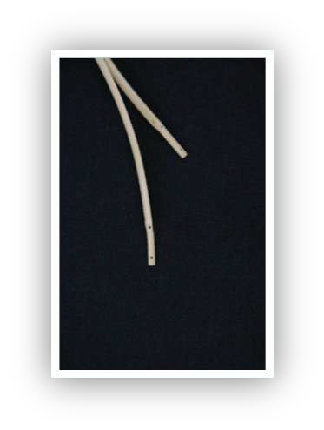
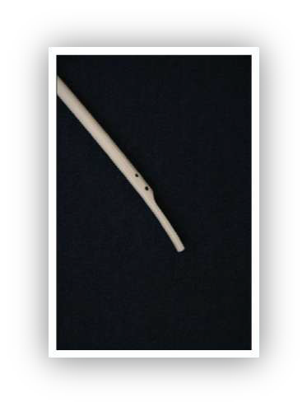
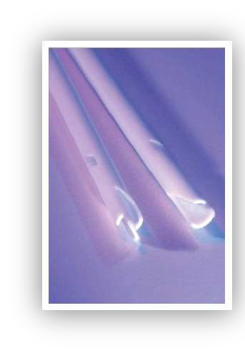
Central Venous Catheter Tips
Split Tip
Staggered Tip
Symmetrical Tip
Side Slot
Tal M. et al. Dial Traspl. 2010;31(1):17-20.
Two symmetrical tip catheters showing two views

Slide 7
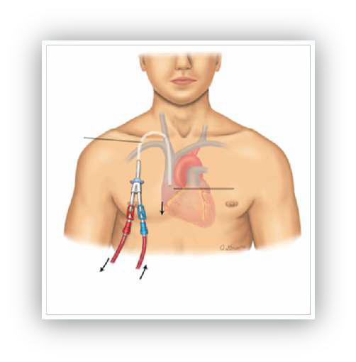
Tip Location
In long-term hemodialysis,
CVCs should have their tips within the right atrium¹
Catheter
Central catheter tip location should be determined radiographically
and documented prior to initiation of therapy²
Right atrium of heart
Blood to dialysis machine
Blood from dialysis machine
Adapted from Vaccharajani TJ. Atlas of Dialysis Vascular Access 2010.
Infusion Nurses Society, J Infus Nurs. 2011;34(1S)

Slide 8
Assessment of CVCs in Hemodialysis
Patients

Slide 9
Do you know what’s in your protocol
regarding catheter assessment?
A dysfunctional catheter usually is easier to salvage than a nonfunctional catheter
(KDOQI 2006)

Slide 10
Four Steps to Assessment
VISUAL INSPECTION
1
CVC PATENCY ASSESSMENT
2
ASSESS TYPE OF DYSFUNCTION
3
ONGOING ASSESSMENT DURING TREATMENT
4
10

Slide 11
STEP 1: Visual Inspection
1
PRIOR TO DIALYSIS VISUAL INSPECTION OF:
Exit Site
Patient
Central Venous Catheter (CVC)
Redness
Discharge
Swelling
Bruising
Bleeding
Tenderness
Neck and facial swelling
Development of collateral circulation
Any concerns from the patient regarding central venous catheter access
Line Integrity
Holes
Cracks
Cuff location
Wood, CANNT Nursing Standards. April 8,2014
11

Slide 12
STEP 2: CVC Patency Assessment
2
ASSESSMENT OF CVC PRIOR TO INITIATING DIALYSIS^{1,2}
Remove anticoagulation lock
Holding arterial lumen, attach syringe
Open clamp, aspirate anticoagulant, blood and/or clots
Discard the syringe
Assess patency
Attach a 10 mL syringe
Aspirate back 3-5 mL of blood to check for clots and flow of the lumen
If no clots noted – repeat aspirate/instill (irrigation motion) 3 times to evaluate lumen flow
Flush CVC
Attach the 20 mL (or 2x10 mL) prefilled normal saline syringe and flush each lumen using forceful flush method (total: 20 mL per lumen).
Repeat procedure for the venous lumen
Identification of clots and/or a sluggish flow is an indicator of catheter dysfunction
Adapted from CANNT Journal, Supplement 1. 2006; 16:1-20.
Adapted from BC Renal. Vascular Access Guideline 2011.
12

Slide 13
STEP 3: Assess Type of Dysfunction
3
PROMPTLY ASSESS AND MANAGE
ANY FORM OF DYSFUNCTION IDENTIFIED
Non-thrombotic
Thrombotic
Hill, J, et al., Vascular Access 2013:7(Supplement 1)

Slide 14
Rule out Non-thrombotic Causes of
Dysfunction
CAUSES OF NON-THROMBOTIC
CATHETER DYSFUNCTION INCLUDE:
Kinked tubing
Cracks or leakage in CVC
Constriction of CVC due to improperly placed sutures at insertion site
Catheter tip migration
Malposition of the catheter
Closed clamps
Patient position
KDOQI 2006 Clinical Practice Guidelines and Clinical Practice Recommendations, Vascular Access, 2006 S249 – S251

Slide 15
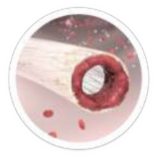

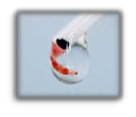
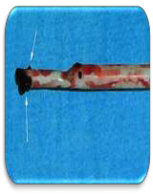
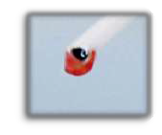







CVC Patency Assessment May
Determine Type of Thrombotic Occlusion
© Penny Offer, CRNI
© Penny Offer, CRNI
Partial Occlusion¹
Decreased ability to infuse fluids; resistance with flushing and aspiration
Sluggish flow through the catheter
May be caused by intraluminal thrombus or fibrin sheath
Withdrawal Occlusion¹
Inability to aspirate blood but ability to infuse without any resistance
May be caused by fibrin tail
May result in line revseral²
Complete Occlusion¹
Inability to infuse or withdraw blood or fluid
Hill, J, et al., Vascular Access 2013:7(Supplement 1)
KDOQI 2006 Clinical Practice Guidelines and Clinical Practice Recommendations, Vascular Access, 2006

Slide 16
What criteria do you use to assess CVC dysfunction during dialysis?

Slide 17



STEP 4: Ongoing Assessment During Treatment
4
SIGNS OF CVC DYSFUNCTION
Patient/Catheter Related
Machine Related
>10%  Q_{B} from baseline¹
Blood pump flow rates (BFR< 300 mL/min)¹
Arterial pressure  (< -250 mm Hg)¹
Venous pressure  (> 250 mm Hg)¹
URR/PRU progressively < 65% (or Kt/V <1.2)¹
Frequent pressure alarms – not responsive to patient repositioning or catheter flushing¹
Blood processed < 65 L/session²
>10% recirculation
Need for frequent line reversal
Pain³
Bleeding³
Respiratory distress³
Catheter integrity³
Unable to aspirate blood freely¹
In CVCs, the most likely cause for low BFRs is thrombotic occlusion. (KDOQI 2006)
KDOQI 2006 Clinical Practice Guidelines and Clinical Practice Recommendations, Vascular Access, 2006 S249 – S251
Ward DR, et al. Can J Kidney Health Dis. 2014 Jul 8;1:15.
Wood, CANNT Nursing Standards. April 8,2014.
17

Slide 18
Thrombotic Dysfunction
Identification

Slide 19







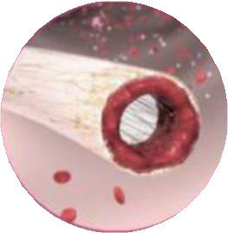
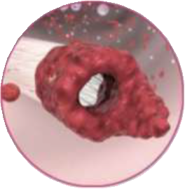
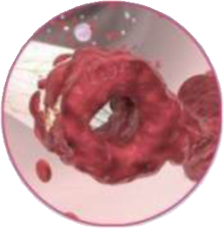
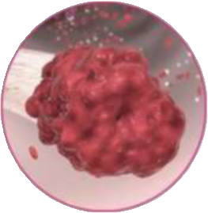
Types of Thrombotic Occlusions
Images courtesy of A. Questell.
Used with permission.
1. Intraluminal Thrombus
2. Fibrin Tail
3. Mural Thrombus
4. Fibrin Sheath
Hill, J, et al., Vascular Access 2013: 7 (Supplement 1)

Slide 20
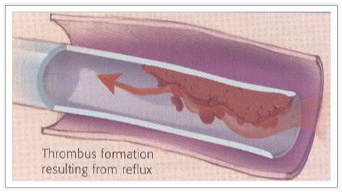
1. Intraluminal Clot
WHEN ASSESSING
YOU MAY FIND:
Aspiration: resistance upon aspiration
Flushing: decreased ability to infuse fluids
Hill, J, et al., Vascular Access 2013: 7 (Supplement 1)

Slide 21

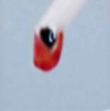

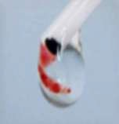
2. Fibrin Tail
WHEN ASSESSING
YOU MAY FIND:
Acts as a one-way valve that permits infusion but not withdrawal of fluid from the catheter¹
Line reversal may be required to dialyze if a fibrin tail is present.²
© Penny Offer, CRNI
Aspiration: the tail gets “sucked back” over the opening when blood aspiration is attempted¹
© Penny Offer, CRNI
Flushing:
tail gets pushed
aside by the positive pressure of infusing¹
1. Hill, J, et al., Vascular Access 2013:7(Supplement 1)
2. KDOQI 2006 Clinical Practice Guidelines and Clinical Practice Recommendations, Vascular Access, 2006
21

Slide 22


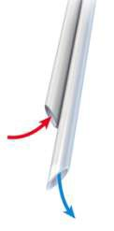
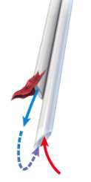
Line Reversal
THE NEED TO LINE REVERSE MAY BE A SIGN OF DYSFUNCTION^{1,2}
Arterial
Venous lumen
Arterial
Venous
lumen
lumen
lumen
Normal Position
Lines
Reversed
Blood leaves patient to
dialysis machine
Blood returns from machine
to patient
Access recirculation occurs when dialyzed blood exiting the outflow lumen directly re-enters the inflow lumen thereby bypassing the systemic circulation²
1. KDOQI Clinical Practice Guidelines and Clinical Practice Recommendations, Vascular Access 2006.
2. Vesely TM. EV Today. 2013 Jun;60-2.
22

Slide 23
Line Reversal May Compromise HD
Adequacy
Access recirculation >10% occurred in 86% of patients when lines were reversed compared to 3% when lines ran in straight position¹
A HD catheter recirculation rate >10% reduces the effectiveness
(adequacy) of hemodialysis treatment²
Line reversal should only be used temporarily until the problem is
definitively corrected³
1. Pannu N, et al. ASAIO J. 2006 Mar-Apr;52(2):157-62.
2. Vesely TM. EV Today. 2013 Jun;60-2.
3. KDOQI Clinical Practice Guidelines and Clinical Practice Recommendations, Vascular Access 2006.
23

Slide 24

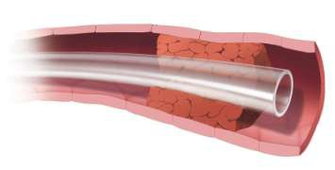


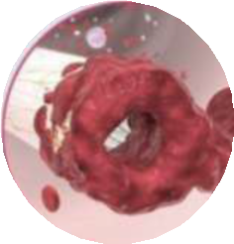
3. Mural Thrombus
WHEN ASSESSING YOU MAY FIND:
Depending on location of thrombus, may or may not be symptomatic upon syringe assessment¹
Swelling, pain, tenderness,
engorged vessels²
Can result in partial or complete occlusion of the vein¹
Images courtesy of A. Questell.
Used with permission.
1. Hill, J, et al., Vascular Access 2013: 7 (Supplement 1)
2. Besarab A. Clin J Am Soc Nephrol 6: 227–234, 2011.
24

Slide 25
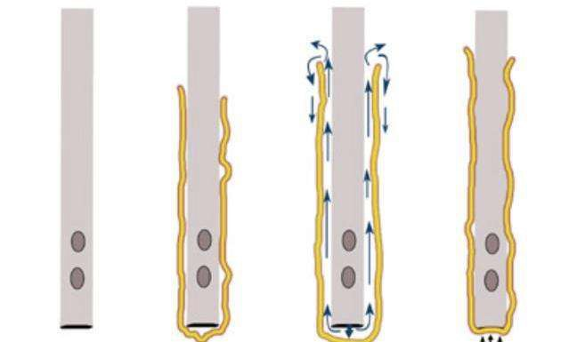
4. Fibrin Sheath
WHEN ASSESSING YOU MAY FIND:
Aspiration: inability or
difficult to withdraw blood
Flushing: resistance or inability to infuse fluids
Fibrin sheath creates a “sock” over the end of the catheter or its whole length
Hill, J, et al., Vascular Access 2013: 7 (Supplement 1)
25

Slide 26
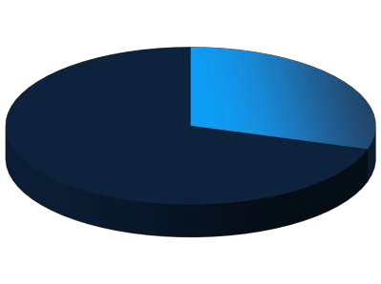
4. Fibrin Sheath
CANADIAN STUDY OF 47 LONG-TERM HEMODIALYSIS PATIENTS WITH SECONDARY CATHETER DYSFUNCTION
Fibrin sheaths were present
in 33/47 (70%) of patients at the time of guidewire exchange
No sheath 30%
Fibrin sheath 70%
Patients with sheaths had:
significantly lower urea reduction ratio (66% vs. 73%, p < 0.001)
higher percentage of inadequate
hemodialysis treatments
(27% vs. 9.8%, p=0.01)
Oliver MJ et al. Clin J Am Soc Nephrol 2007;2:1201-1206.
26

Slide 27
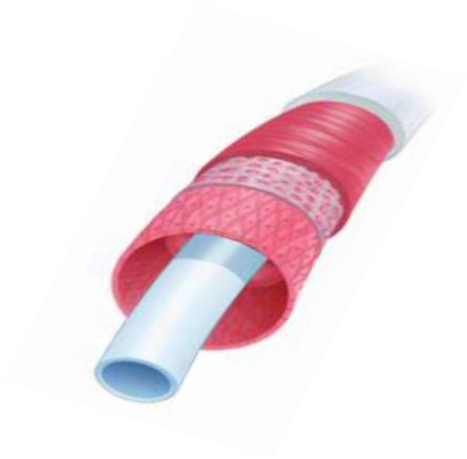


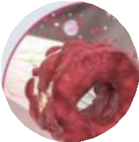


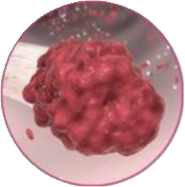
Thrombus Formation Can Occur
Within 24 Hours
Fibrin sheath may form around intravenous catheters within 24 hours of CVC insertion, and then continues to evolve over weeks/months to contain collagen and even smooth muscle²
Hoshal VL Jr, Ause RG, Hoskins PA. Arch Surg. 1971 Apr;102(4):353-8.
27

Slide 28
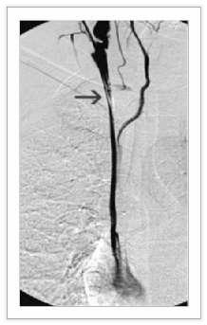
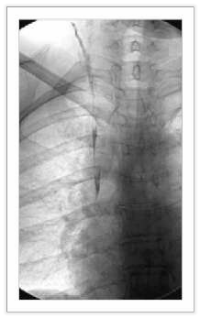


What happens to the fibrin sheath at
time of catheter removal?
Sheath remains attached to the vein after catheter removal
A
C
Fibrin sheath
Fibrin sheath
Catheter tip
The tip of the catheter (arrow) was pulled back and contrast was injected to demonstrate the whole sheath material
The catheter was removed completely and the sheath remained attached to the vein wall and did not embolize
Oguzkurt L, et al. Nephrol Dial Transplant Aug 25 2007;22:3677-9.
28

Slide 29
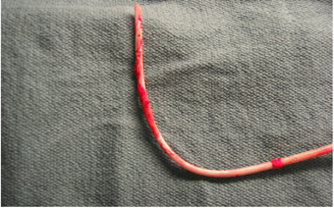
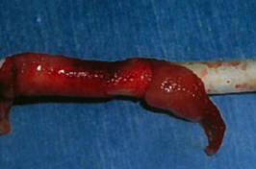
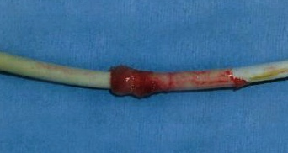
Cl
ot Morphology Over Time
Fresh fibrin sheath¹
Adhered fibrin sheath²
Fibrin sheath with cuff
Organized fibrin sheath³
1. Mokrzycki MH, et al. Kidney International Sept 2010 78:1218–31.
Salgado OJ. Vascular Access for Hemodialysis. Overview and Emphasis on Complications 2013.
Vaccharajani TJ. Atlas of Dialysis Vascular Access 2010.
29

Slide 30
Catheter Dysfunction
Possible Complications
Photo courtesy P. Offer

Slide 31
What are some possible consequences of CVC-related thrombosis?
Photo courtesy P. Offer

Slide 32


Hemodialysis Inadequacy
Inadequate Dialysis: Urea Clearance <65% or Kt/V <1.2
Signs & Symptoms of Inadequate Dialysis
Fatigue
Loss of appetite
Altered taste
Nausea
Vomiting
Pruritis
Difficulty concentrating
Weight loss
Anemia
Secondary hyperparathyroidism
Neuropathy
Restless legs
Abnormal electrolytes
Pericariditis
Changes in cognitive function
Wood, CANNT Nursing Standards. April 8,2014.

Slide 33

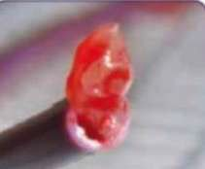







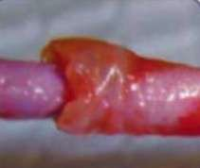
Infection
CVC–related infection might induce an inflammatory response and coagulation response
Thrombus formation would in turn promote catheter colonization and bacterial biofilm growth
Photos courtesy of Penny Offer
Boersma RS et al. Annals of Oncology 2008; 19:433-442

Slide 34
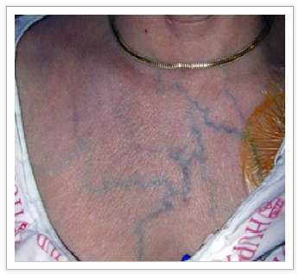
SVC Syndrome
SIGNS AND SYMPTOMS INCLUDE:^{1,2,3}
Pain
Swelling
Edema
Erythema
Engorged peripheral veins in upper body
Development of collateral circulation
Feeling of head “fullness”
Severe headache
Blurred vision
Dysphagia
Dyspnea
(shortness of breath)
Photo courtesy of Dr. Scott Trerotola
Baskin JL, Reiss U, Wilimas JA, et al. Hematological 2012;97(5):641–50
Rupert RA. AJN October 2007 107(10): 72C-72G.
Medline Plus. National Institute of Health, SVC Obstruction, updated 1/1/2013

Slide 35
How does proper CVC assessment
impact patient care?
ONGOING ASSESSMENT DURING TREATMENT

Slide 36
Reference (1 of 2)
Baskin JL, Reiss U, Wilimas JA, et al. Thrombolytic therapy for central venous catheter occlusion.
Haematological 2012;97(5):641–50.
Besarab A, Pandey R. Catheter management in hemodialysis patients: delivering adequate flow. Clin J Am Soc
Nephrol. 2011 Jan;6(1):227-34.
Boersma RS et al. Thrombotic and infectious complications of central venous catheters in patients with hematological malignancies. Annals of Oncology 2008; 19:433-442.
BC Renal. Vascular Access Guideline 2011.
Graham J et al. Factors influencing the prevalence of central venous catheter use in a Canadian haemodialysis
centre. Nephrol Dial Transplant. 2008 Nov;23(11):3585-91.
Hill J, Broadhurst D, Miller K, et al. Occlusion Management Guideline for Central Venous Access Devices (CVADs). Vascular Access 2013;7(Suppl 1):1-34.
Hoshal VL Jr, Ause RG, Hoskins PA. Fibrin sleeve formation on indwelling subclavian central venous catheters.
Arch Surg. 1971 Apr;102(4):353-8.
Infusion Nurses Society. Infusion Nursing Standards of Practice. J Infus Nurs. 2011;34(1S):S1-110.
Medline Plus. National Institute of Health, SVC Obstruction, updated 1/1/2013.
National Kidney Foundation (NKF). KDOQI clinical practice guidelines and clinical practice recommendations for 2006 updates: Guideline 7. Prevention and treatment of catheter and port complications. American Journal of Kidney Disease July 2006;48(1)(Suppl 1):S2487-S257.
Network CE. Clinical educators network nursing recommendations for management of vascular access hemodialysis patients. CANNT Journal 2006;16(Suppl 1):1-20.

Slide 37
References (2 of 2)
Mokrzycki MH, Lok CE. Traditional and non-traditional strategies to optimize catheter function: go with more flow. Kidney Int. 2010 Dec;78(12):1218-31.
Oguzkurt L, Ozkan U, Torun D, et al. Does a fibrin sheath formed around a catheter embolize upon removal of the catheter? Nephrol Dial Transplant Aug 25 2007;22:3677-9.
Oliver MJ, Mendelssohn DC, Quinn RR, et al. Catheter patency and function after catheter sheath disruption: A pilot study. Clin J Am Soc Nephrol 2007;2:1201-1206.
Pannu N, Jhangri GS, Tonelli M. Optimizing dialysis delivery in tunneled dialysis catheters. ASAIO J. 2006 Mar-Apr;52(2):157-62.
Rupert RA. Superior vena cava syndrome. AJN October 2007 107(10): 72C-72G.
Salgado OJ. Vascular Access for Hemodialysis - Overview and Emphasis on Complications. In: Suzuki H,
editor. Hemodialysis. InTech; 2013.
Shier D. Hole's human anatomy & physiology. Dubuque, IA: W.C. Brown Publishers; 1996.
Tal M, Ni N. Features of chronic hemodialysis catheters and common complications. Dial Traspl.
2010;31(1):17-20.
Vaccharajani TJ. Atlas of Dialysis Vascular Access. Wake Forest; 2010.
Vesely TM. The Challenges of Hemodialysis Catheter Use. EV Today. 2013 Jun;60-2.
Ward DR, Moist LM, MacRae JM, Scott-Douglas N, Zhang J, Tonelli M, et al. Risk factors associated with hemodialysis central venous catheter malfunction; a retrospective analysis of a randomized controlled trial. Can J Kidney Health Dis. 2014 Jul 8;1:15.
Wood M. CANNT Nursing Standards. April 8, 2014.

